Slide 1


Slide 2
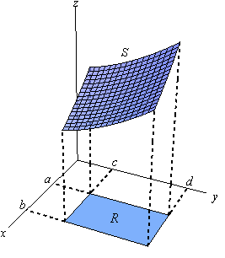
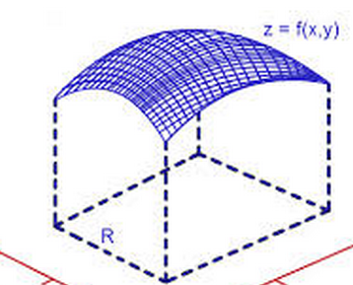

Slide 3
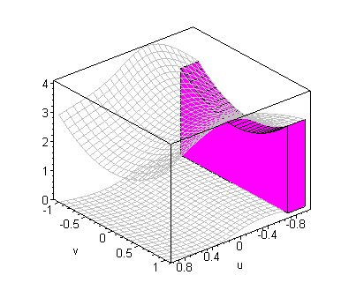
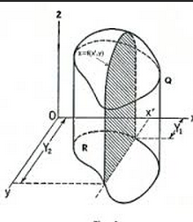

Slide 4
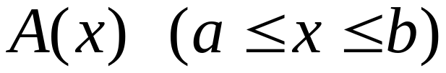
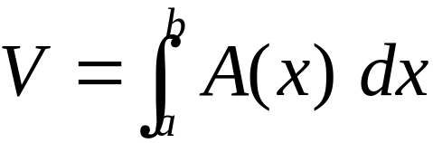
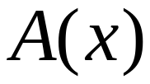



Recall
Finding the volume (slice)
The area of cross section
Then the volume

Slide 5
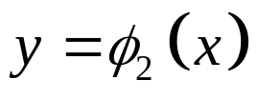

The Type I Region
y
D
O
a
x
b
x

Slide 6

Type I

Slide 7
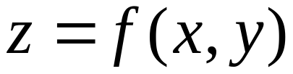
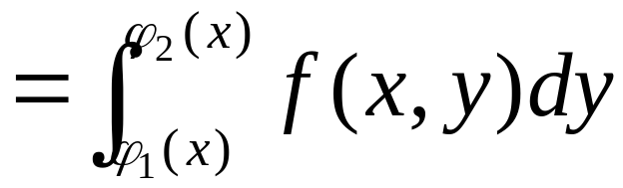

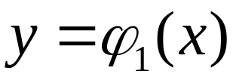
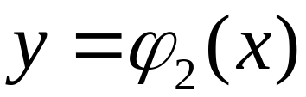

Slide 8
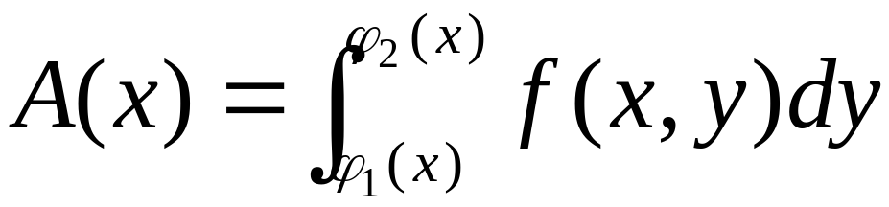

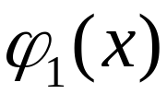
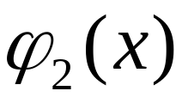
x “constant”

Slide 9
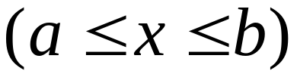
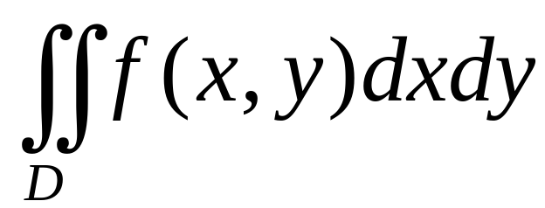
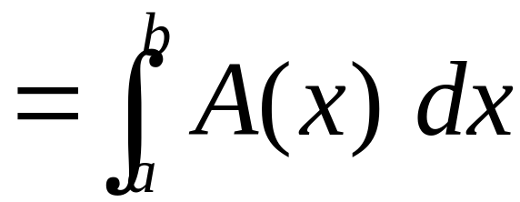

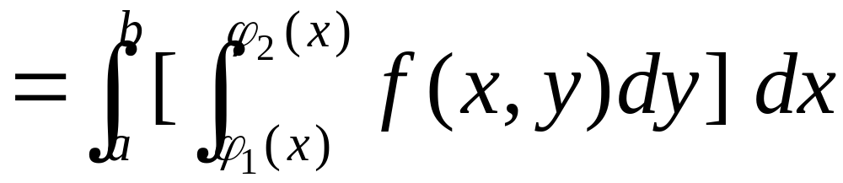
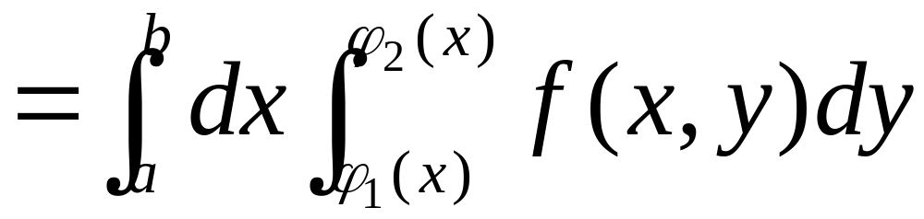
Iterated integral

Slide 10
Integration with respect y first ：
“constant”

Slide 11
With respect to y, x can be regarded as a constant in the first integral

Slide 12
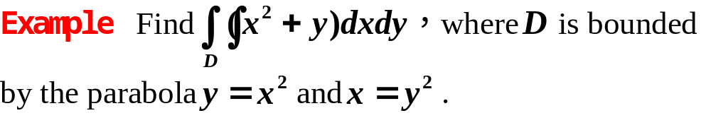
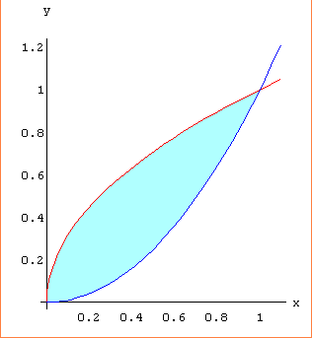
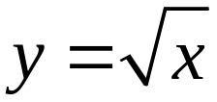
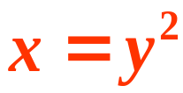

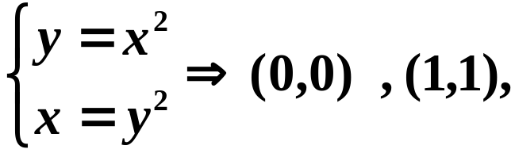
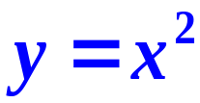
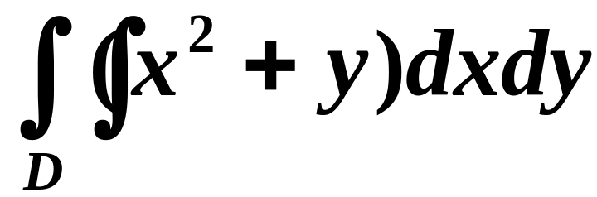
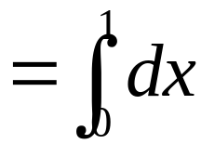
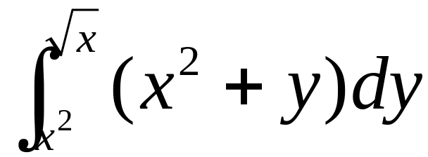
solution
Type, with respect to y first

Slide 13
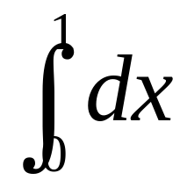
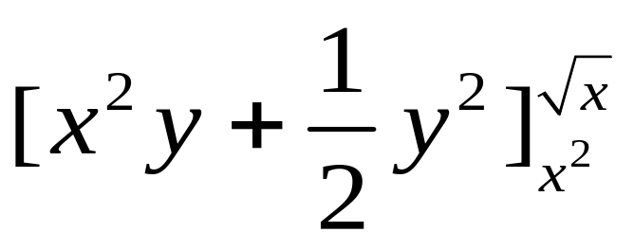
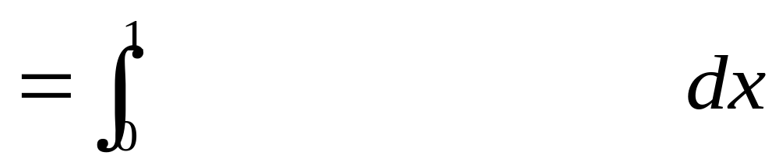
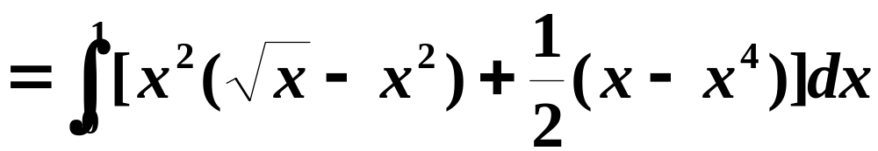
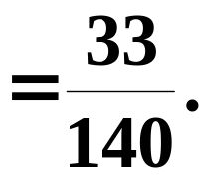

Slide 14


The Type II Region
y
d
D
y
c
O
x

Slide 15
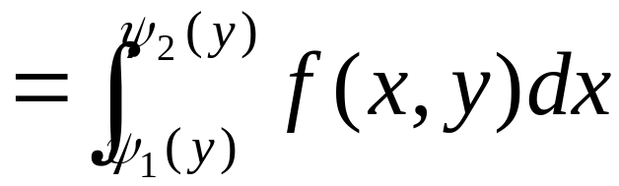
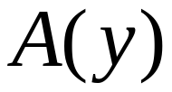
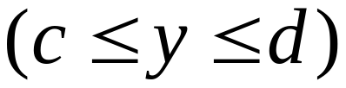
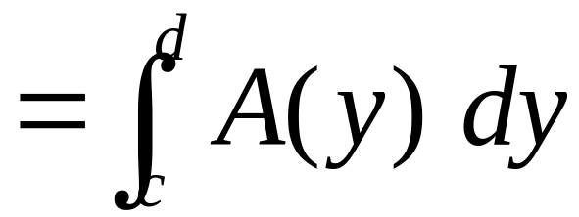
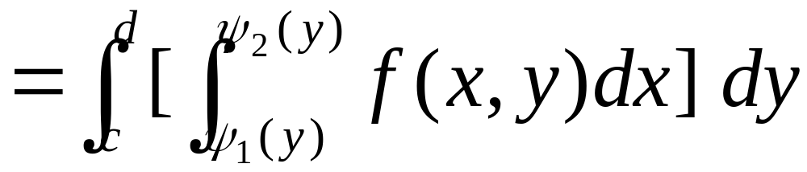
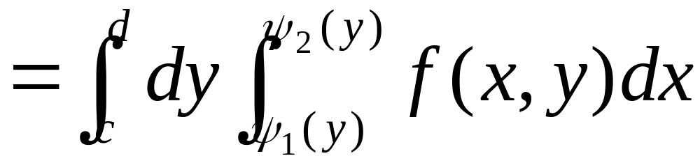
Iterated integral

Slide 16

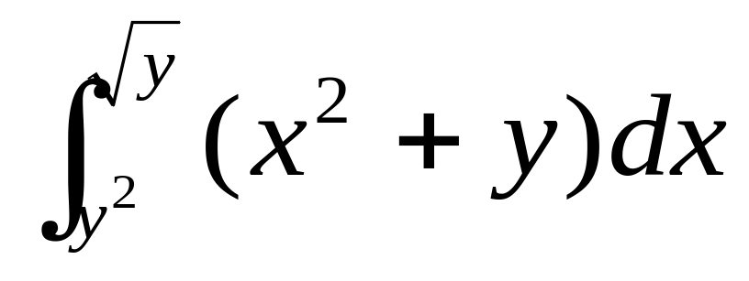
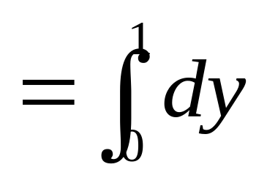
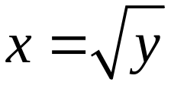
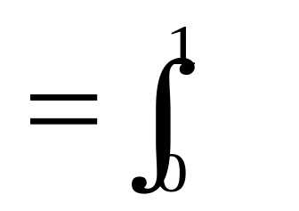
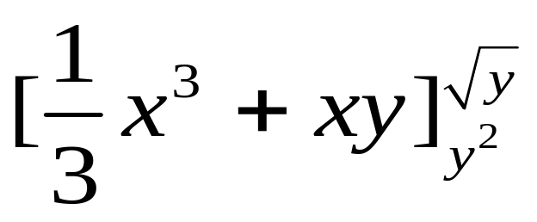
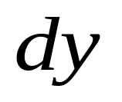
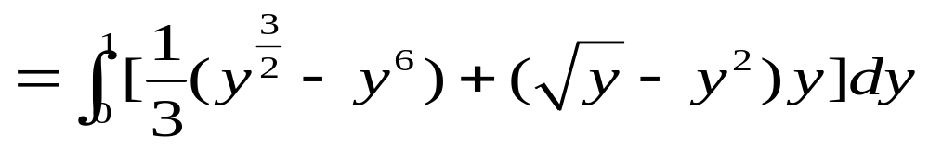
Alternative solution
Type II region, with respect to x first
Type II

Slide 17
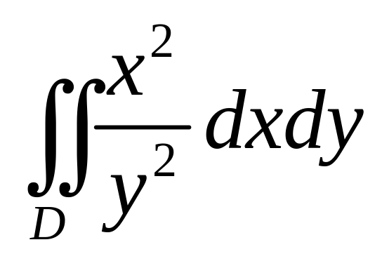

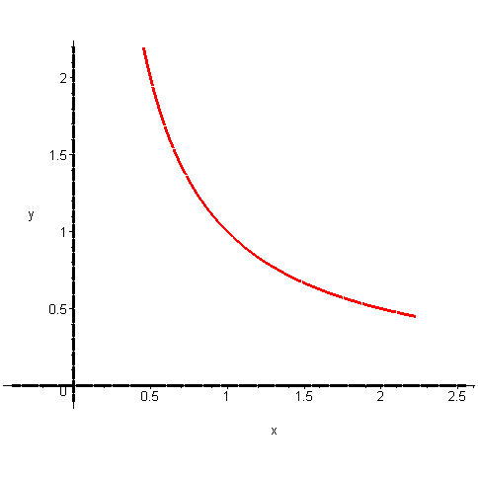

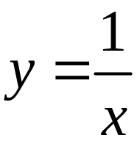
Example
Find
Solution
graphs
Intersection points：(1, 1)
(1/2, 2)
(2, 2)
quxian:=implicitplot(y=1/x,x=0.1..2.22,y=0..2.2,thickness=3,scaling=constrained):
x_axis:=implicitplot(y=0,x=-0.4..2.55,y=-0.1..0.1,thickness=3,scaling=constrained,color=black): y_axis:=implicitplot(x=0,x=-0.1..0.1,y=-0.1..2.2,thickness=3,scaling=constrained,color=black):
display(quxian,x_axis,y_axis);

Slide 18









If Type I
Evaluate two integrals

Slide 19





Type II
In this case, easier

Slide 20







解
Sketch the region of integration D
重新定限
将D视为另一类型的区域
X型区域
Y型区域

Slide 21










改变积分次序：

Slide 22




合并
X型区域
Y型区域
原积分

Slide 23


Change the order of integration
Sketch the region of integration, then
Write an equivalent with the order of
Integration reversed.

Slide 24








计算二次积分
若先积分
则“积不出”
原函数不是初等函数
常见的“积不出”的积分：
在二重积分中不要先去碰这些积分

Slide 25







怎么办？
视为常数！
改变积分次序，避开这个“积不出”的积分
这下好办了！
X型
Y型

Slide 26











例
圆环区域用直角坐标定限十分复杂

Slide 27


Slide 28
End

